Slide 1


Slide 2
Overview
Based on the Spark core API i.e. RDD’s
Enables scalable, high-throughput, fault-tolerant stream processing of live data streams
Data is consumed from any source that can provide a (almost) continuous stream
The consumed data is processed using distributed algorithms like map, reduce, filter, join etc.
Finally, processed data can be pushed out to file systems, databases, and live dashboards
Spark Streaming provides a high-level abstraction called discretized stream or DStream, which represents a continuous stream of data
Internally, a DStream is represented as a sequence of RDDs
Notes:
Complete processing platform .It cover any scenario . We have seen fixed amount of data processing .(batch) then data set .Data arrives at particular rate .Example of streaming data is IoT. Around 370 millions twits .Every day how many post in face book ? 450millions post .LinkedIn also generates data . Whatever the rate data arrives ,its important .That does not define the streaming system. The streaming system defines by continuous flow or continuous stream of data arrives to us .challenge is the processing .we saw the processing of batch data but what about streaming ?For this second I got 5 twits come on but next second those five seconds twits is gone. then again the next second another 5 twits.so every second the twits changes.so are data is moving.to process this thing we need middle ware .why ? 1. to establish asynchronized communication
=============================================================================================================================================
Effective streaming data processing system ? Simple java can do that but can not deal with big data .two options : 1.Storm ,spark .
Storm is real time (Any data it arrives ,it process right away).spark is not complete real time (spark streaming basically does near time processing).It accumulate the data for some time. Lets assume your data is arriving at the rate of 5 messages per second. what's spark streaming will do ?It will accumulate the data for some times. Lets say 2 seconds. How much time ? That depends on you. you decide. As a developer you configure how much time it requires for accumulating the data? Its called batch interval .Its actually micro batching interval .so what spark streaming does .spark streaming will batches the incoming data .Lets says data arrives as 5 messages per second.
Spark streaming will batch the data for two seconds (we configured it). So what's spark streaming will do is ?it will batch the data for two seconds.it means it creates a batches of up to 10 messages then process that batch and then come back .While process that batch ,a new batch will build up .for two seconds data comes in ,which is 5+5 =10 messages then those 10 messages are now process. While these 10 messages are being processes. Another 5+5 = 10 message will accumulated.so the idea is when it comes to spark streaming ,you have to be very careful about your performance .Why ? Because if you say that my batch interval is two seconds, then you need to make sure by two seconds you are able to process all the data which was accumulated that’s already come in . For example : first two second ,spark is only accumulating the data ,because this is the first micro batch ,next two second ,spark is processing the data accumulated during the first two seconds however the next two seconds, that means the third and fourth seconds when spark is processing the data accumulated during the first and second .
So by end of the forth seconds ,the second batch will be ready for processing.so by end f the forth seconds ,you first batch should already have being processed otherwise your micro batches will keep getting accumulated. And at one point in time you will have out of memory errors.so that’s why spark applications extremely performance intensive .You have to make sure that you have completely processed before new data arrives or new micro batch is constructed.
=====================================================================================================================================
Every batch will be one RDD .if our batch interval is two seconds ,then every two seconds sparks gets an RDD and gives that RDD to you for processing. Every two seconds spark creates an RDD for you to process ,we need to remember that we are not processing an RDD ,we are actually processing something called DStream.

Slide 3
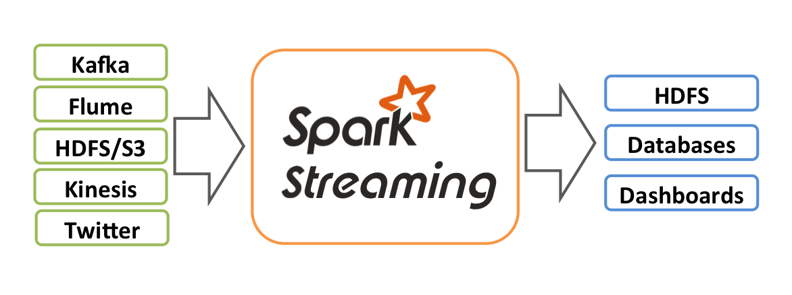
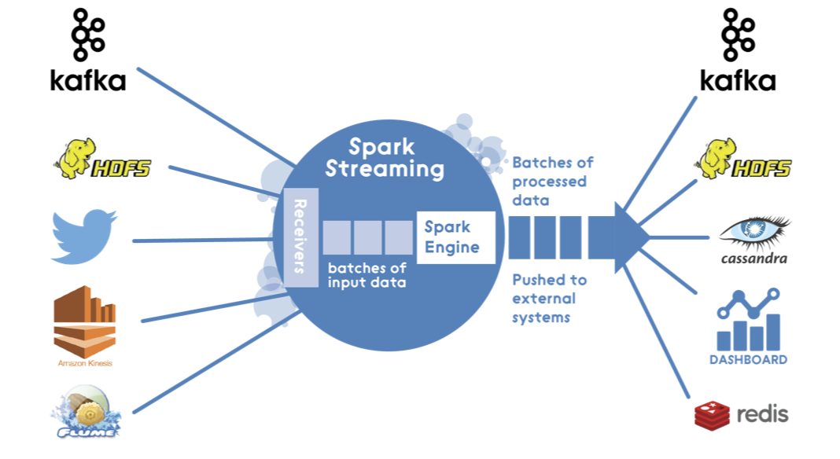
Overview

Slide 4
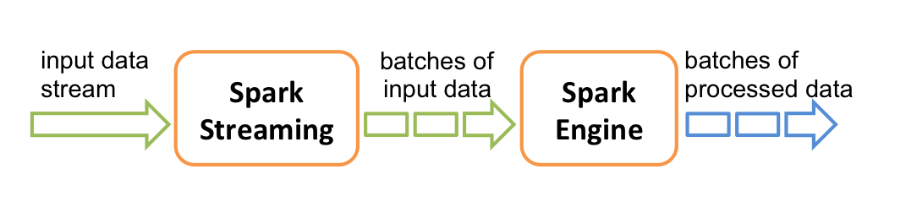
Spark Streaming - Process
Batches ,Each
batch is an RDD
Continuous stream
of Data
Spark splits it to
smaller batches
Processes (your
Computation
,Map ,Filter ,…)
Process them and
moving forward
Every two seconds (for example) spark creates an RDD for you to process ,we need to remember that we are not processing an RDD ,we are actually processing something called DStream.

Slide 5
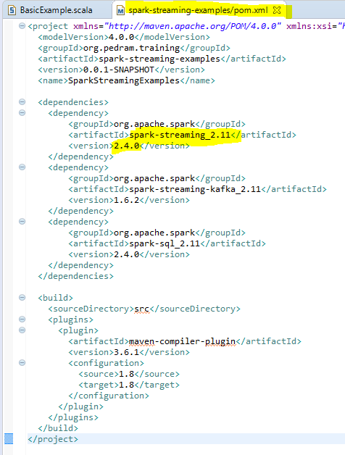
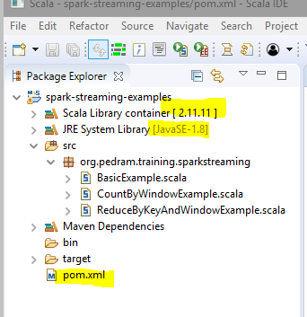
https://mvnrepository.com/artifact/org.apache.spark/spark-streaming

Slide 6
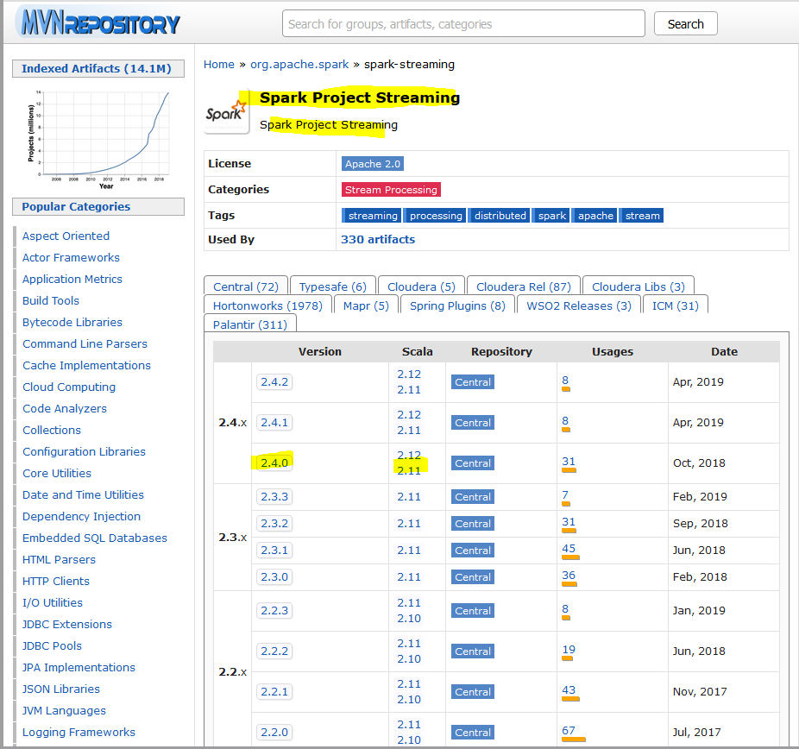

Slide 7
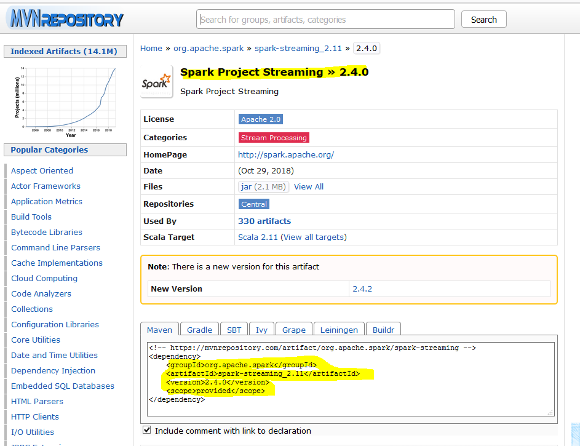

Slide 8
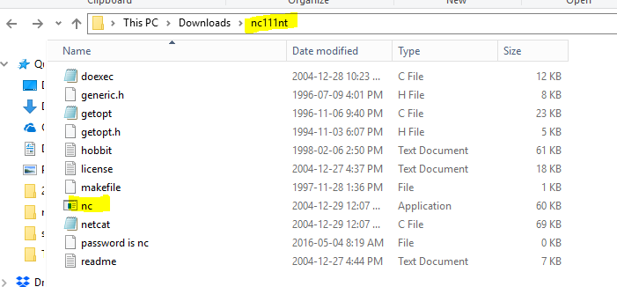
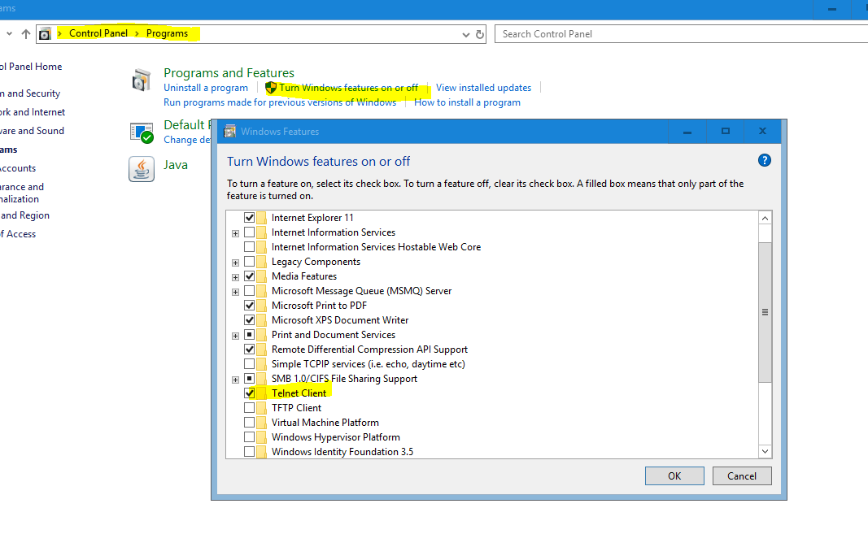
Netcat Server
https://joncraton.org/files/nc111nt.zip

Slide 9
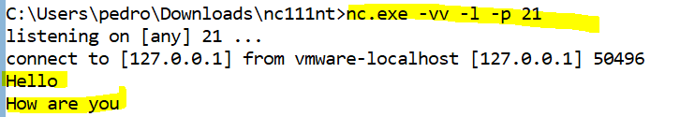
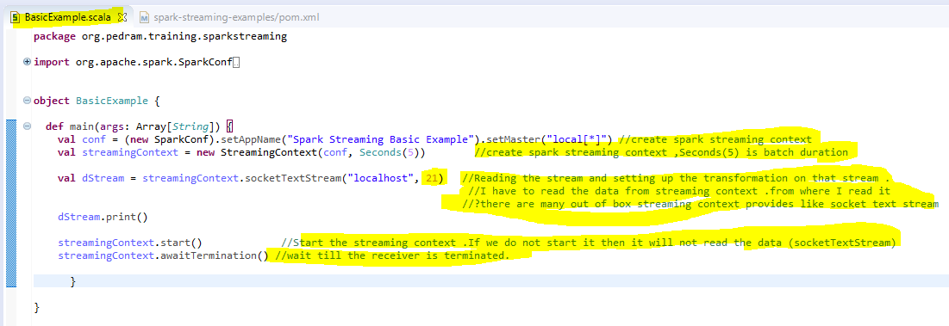
Notes:
In spark streaming four steps we have to do :
1.Creating a streaming context
2.Reading the stream and Setting up the transformation on that stream
3.Start the streaming context .it will create a receiver and it runs a different threat
4. wait till the receiver is terminated.
Netcat Server
nc.exe –v-v -l -p 21

Slide 10
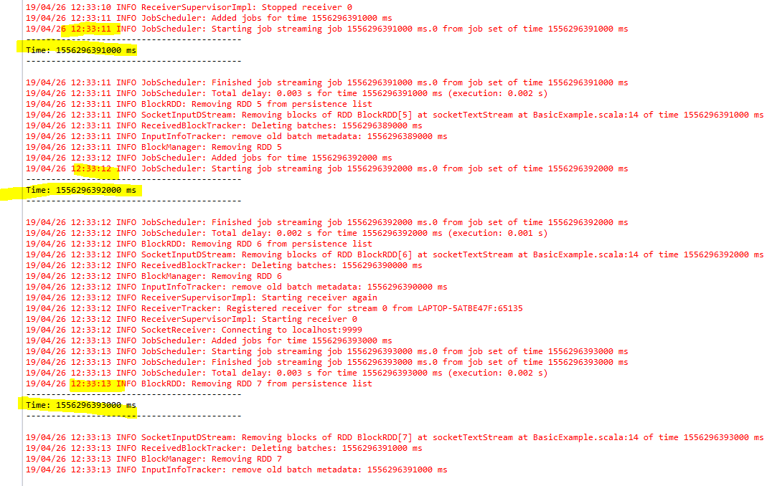
Notes:
That will be continuous running program .Every one second we see something up “time:---------”

Slide 11
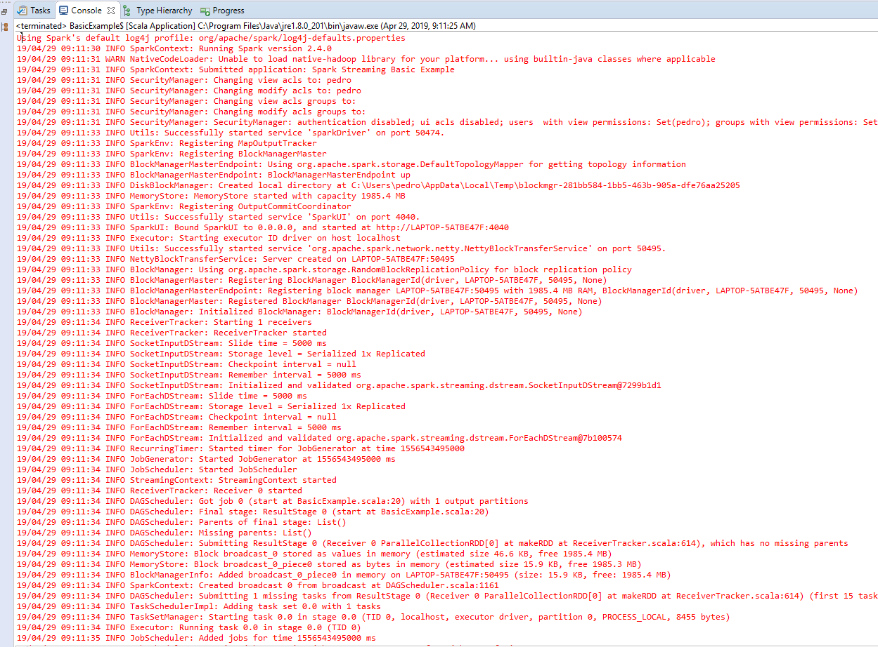

Slide 12
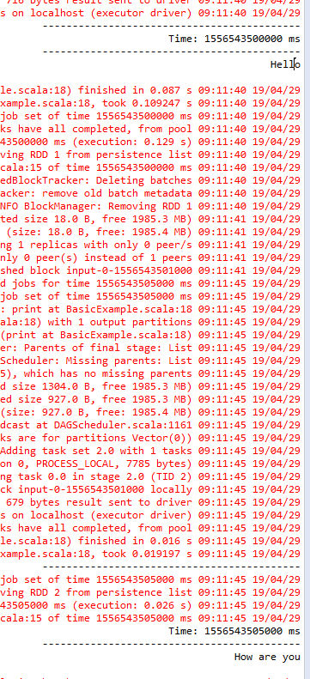
BATCHING
“Hello” is part of the first RDD
“How are you” is part of the second RDD
Notes:
Hello is part of the first RDD
How are you is part of the second RDD

Slide 13
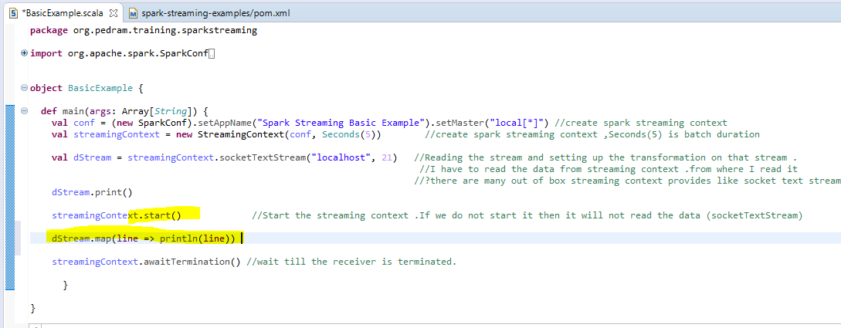
Notes about Streaming Contexts
Once a context has been started, no new streaming computations can be set up or added to it

Slide 14
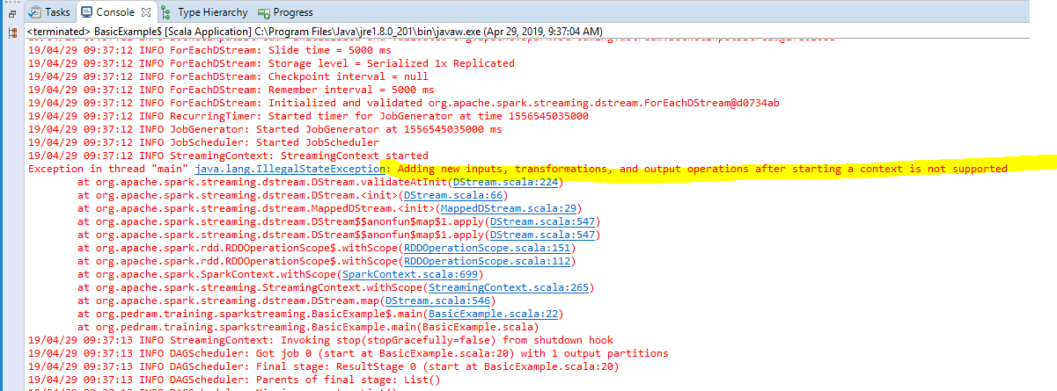

Slide 15
Spark streaming consist of Four steps:
1.Create a streaming context
val conf = (new SparkConf).setAppName("Spark Streaming BasicExample").setMaster("local[*]")
val streamingContext = new StreamingContext(conf, Seconds(5))
2.Create a stream and set up the processing.You declare the processing (we have not started the actual streaming process )
val dStream = streamingContext.socketTextStream("localhost", 21)
Stream.print()
3.Start the streaming context .(when we start the streaming context the actual processing starts which is the top two lines of codes.)
streamingContext.start()
4.Awaittermination : it means you are asking main threat to wait till receiver threat created as a result of the streaming context)
streamingContext.awaitTermination()
Main threat :
===============
val conf = (new SparkConf).setAppName("Spark Streaming Basic Example").setMaster("local[*]")
val streamingContext = new StreamingContext(conf, Seconds(5))
val dStream = streamingContext.socketTextStream("localhost", 21)
dStream.print()
streamingContext.start()
streamingContext.awaitTermination()

Slide 16
Notes about Streaming Contexts
Only one StreamingContext can be active in a JVM at the same time
Only one spark context per JVM
Every streaming context is associated with one spark context.
One streaming context per JVM only.
Notes:
Every streaming context is associated with one spark context. Only one spark context per JVM.

Slide 17
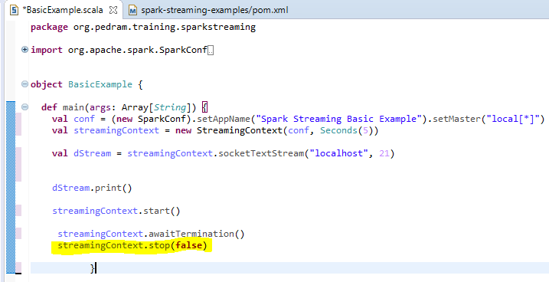
Notes about Streaming Contexts
stop() on StreamingContext also stops the SparkContext. To stop only the StreamingContext, set the optional parameter of stop() called stopSparkContext to false. (Refer to the scaladoc.)
A SparkContext can be re-used to create multiple StreamingContexts, as long as the previous StreamingContext is stopped (without stopping the SparkContext) before the next StreamingContext is created
To stop only the StreamingContext
StreamingContext depends on spark context

Slide 18
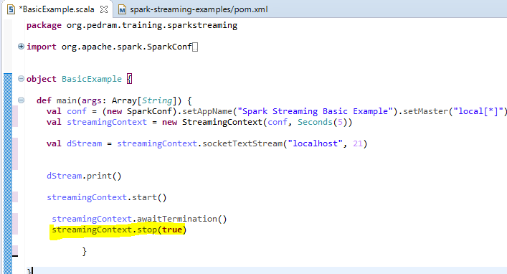
True will stop both : streaming context and spark context. Default is true

Slide 19
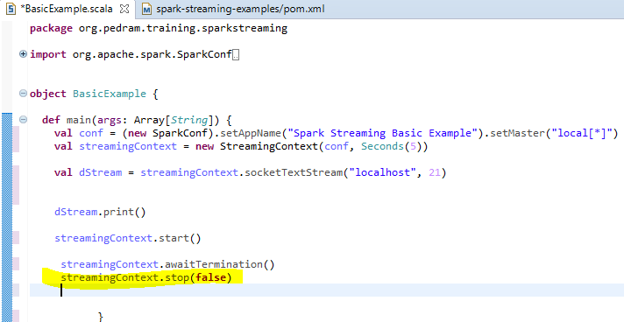
Notes about Streaming Contexts
A SparkContext can be re-used to create multiple StreamingContexts, as long as the previous StreamingContext is stopped (without stopping the SparkContext) before the next StreamingContext is created
Streaming context is different from spark context .Streaming context depends on spark context internally .
Notes:
StreamingContext depends on spark context

Slide 20
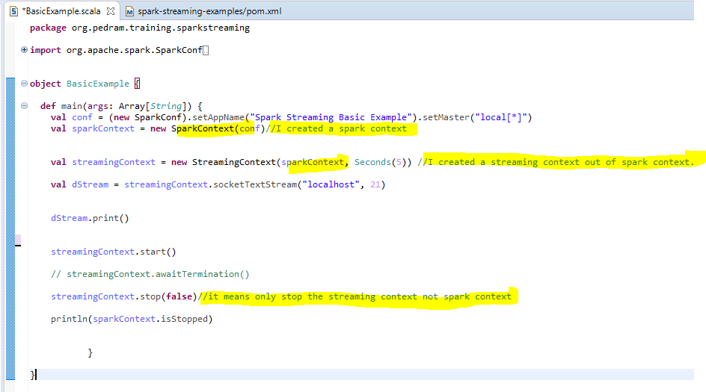

Slide 21
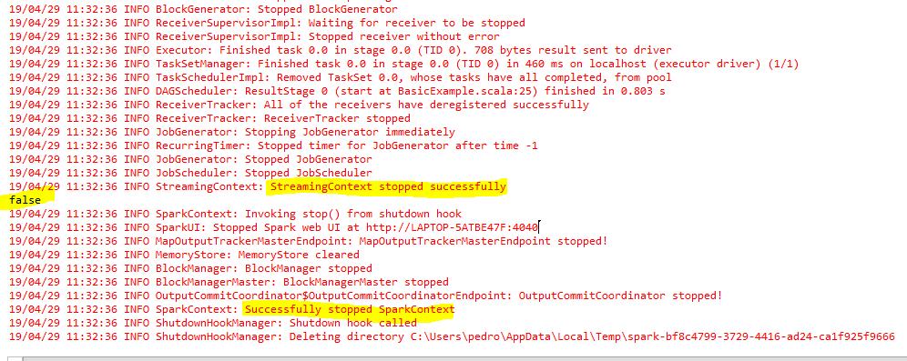

Slide 22
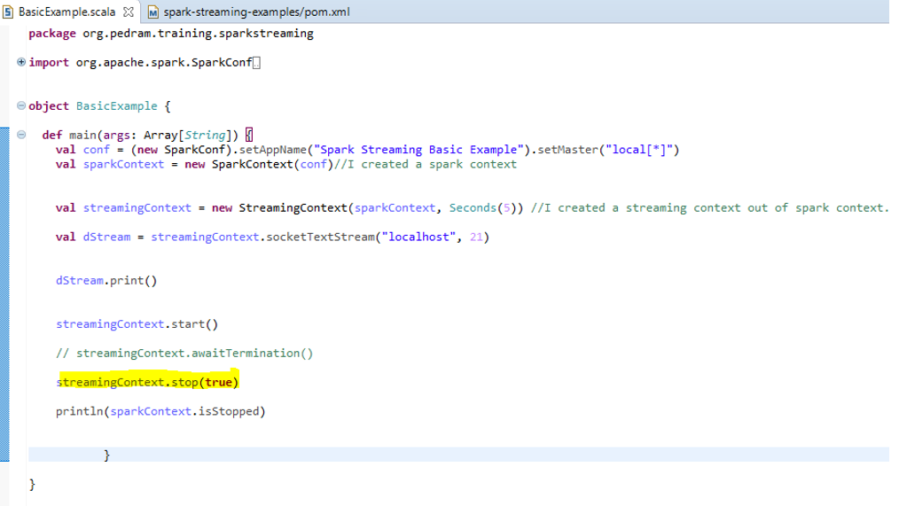

Slide 23
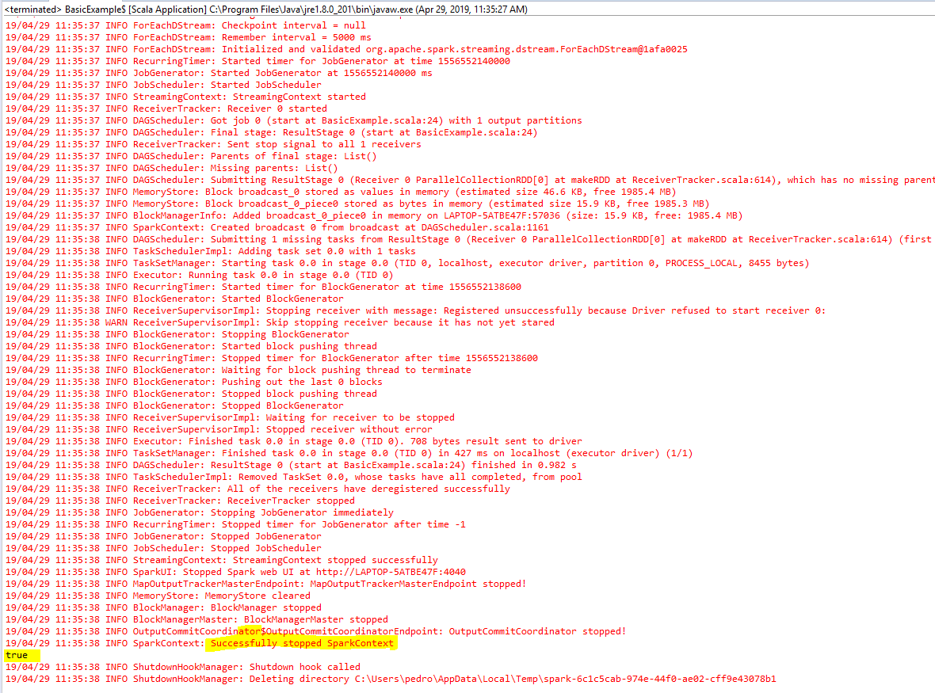

Slide 24
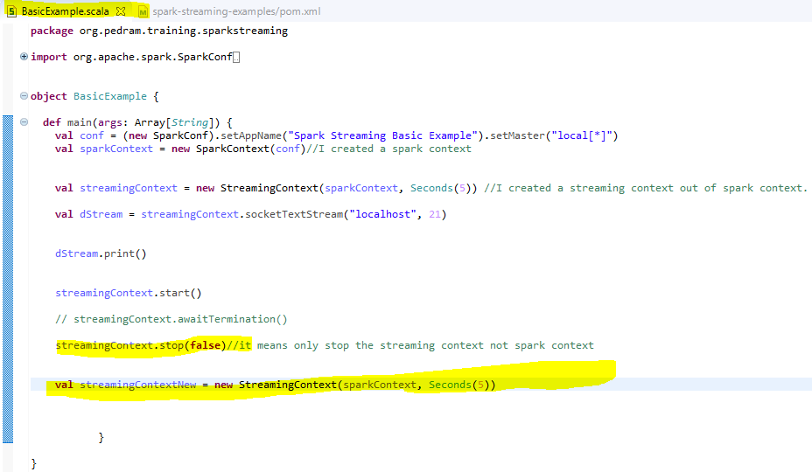
Once we stop the streaming context we can not start it

Slide 25
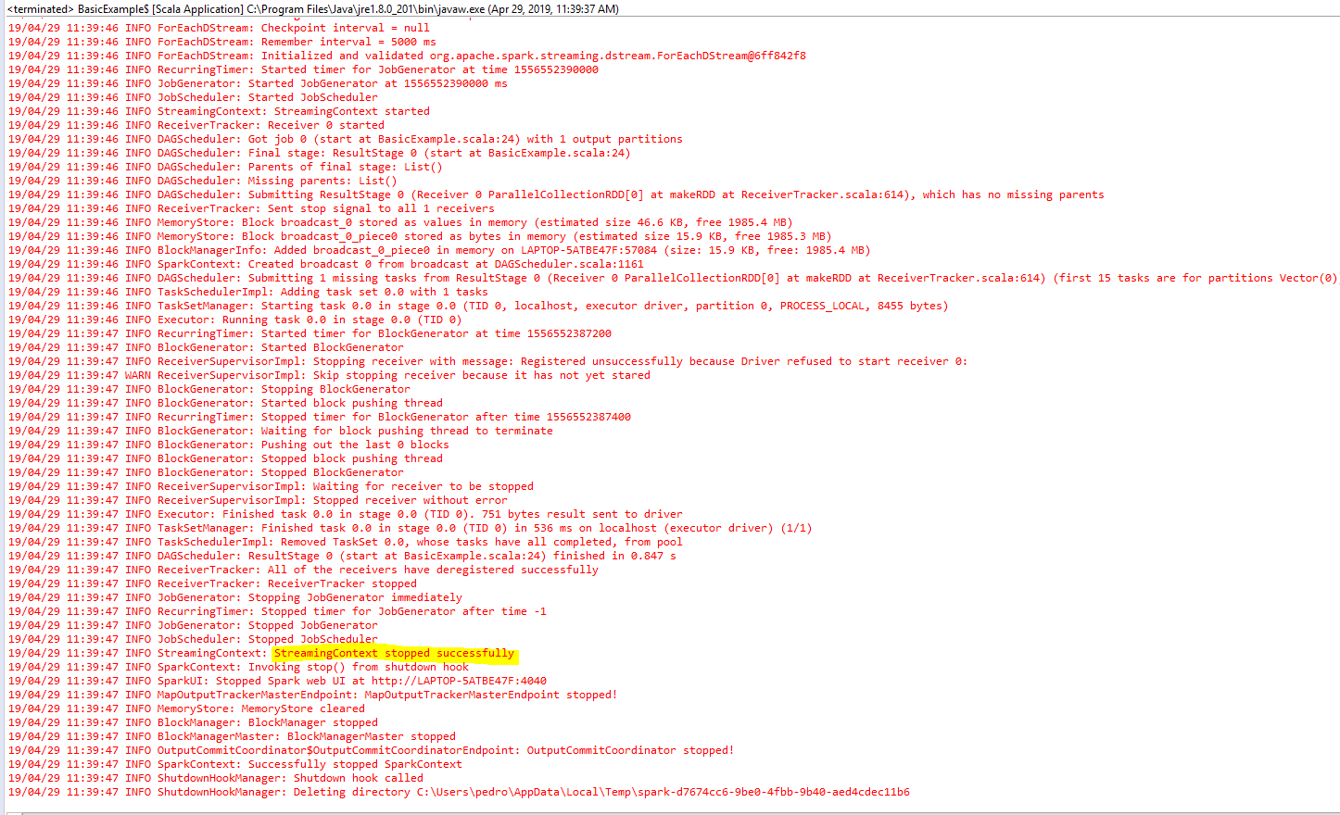

Slide 26
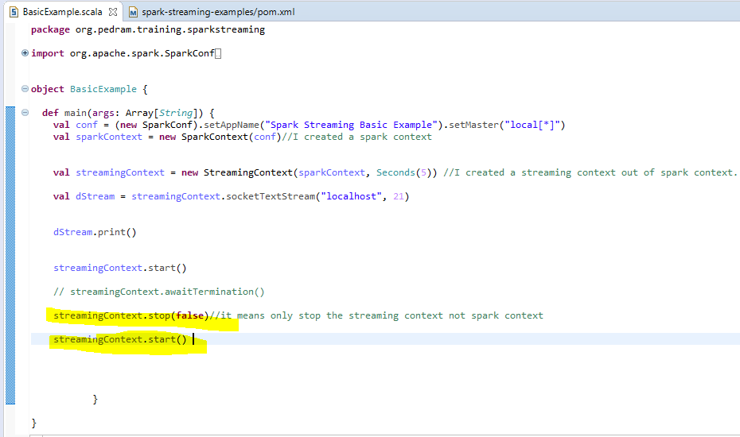
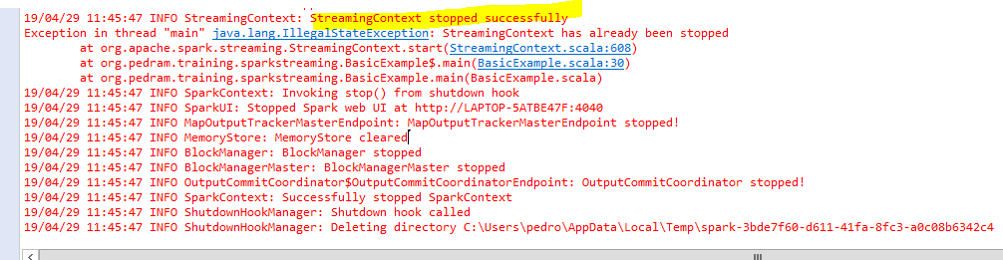
Once we stop the streaming context we can not start the streaming context again

Slide 27
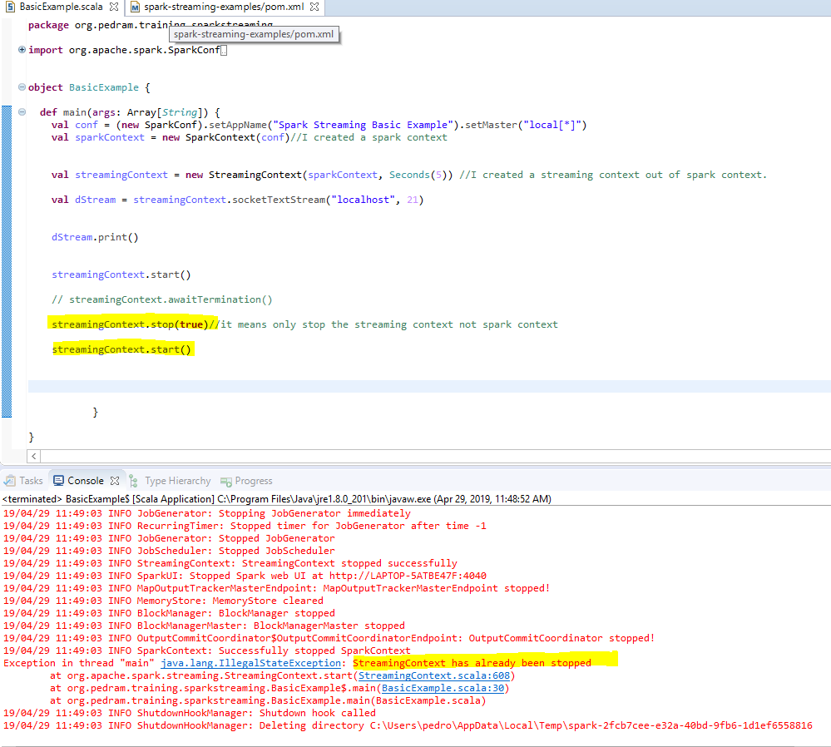

Slide 28
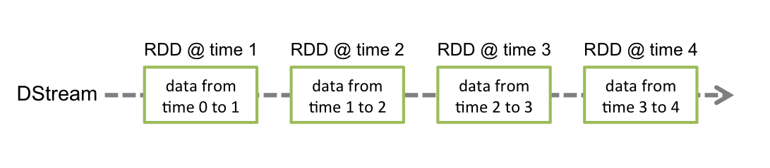
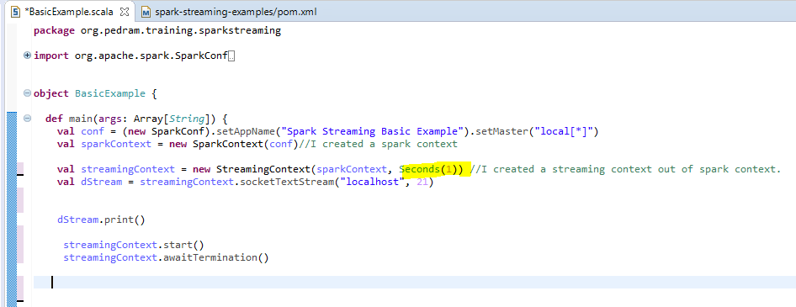
DStream
The entire things is DStream
1st RDD
2ND RDD
3rd RDD
4th RDD

Slide 29
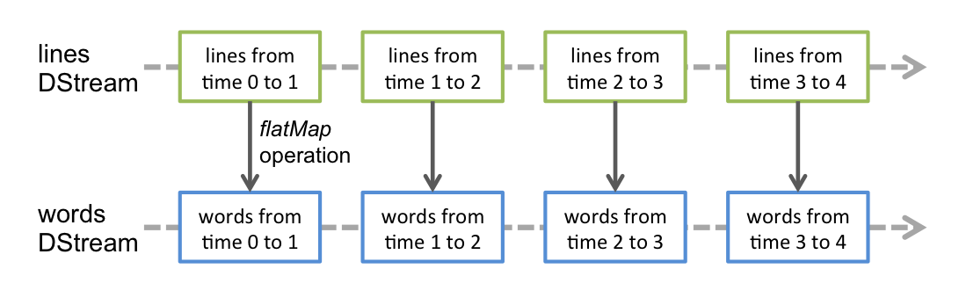
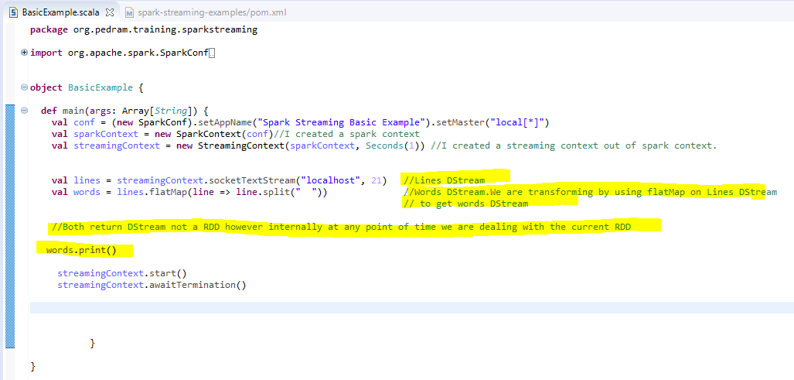
DStream - Transformations
If we are at time 1 (time 0 to 1 is over).It means just at time 1 that become the current RDD. We are running flatMap on this current RDD.
Notes:
When we do a transformation on a particular Dstream even though Dstream is composed of RDD (Dstream is internally an RDD) but we are doing transformation on Dstream not RDD
Actually internally spark is doing transformation on RDD .Spark is transforming the current RDD

Slide 30
The flatMap operation of the top RDD with give us the bottom RDD .Can we choose which RDD we want to operates on ? No
At any point of time we are pointing to the current RDD in Dstream. For program prospective we are working on Dstream .Its spark responsibility to deal with RDD

Slide 31
Other Sources
For reading data from files on any file system compatible with the HDFS API (that is, HDFS, S3, NFS, etc.):
streamingContext.fileStream[KeyClass, ValueClass, InputFormatClass](dataDirectory)
For simple text files:
streamingContext.textFileStream(dataDirectory)
line offset
Notes:
We saw how to read from socket (netcad) what a bout reading from file system?Each line in the file has two attribute :key :line offset with in the file .Tells the location of the line in the file and value is the line itself.

Slide 32
Text File Stream - Rules
A simple directory can be monitored, such as "hdfs://namenode:8040/logs/". All files directly under such a path will be processed as they are discovered
A POSIX global pattern can be supplied, such as "hdfs://namenode:8040/logs/2017/*". Here, the DStream will consist of all files in the directories matching the pattern. That is: it is a pattern of directories, not of files in directories.
All files must be in the same data format
A file is considered part of a time period based on its modification time, not its creation time
Once processed, changes to a file within the current window will not cause the file to be reread. That is: updates are ignored.
The more files under a directory, the longer it will take to scan for changes — even if no files have been modified.
POSIX :regular expression

Slide 33
Queue Streams
For testing a Spark Streaming application with test data, one can also create a DStream based on a queue of RDDs, using the following notation. Each RDD pushed into the queue will be treated as a batch of data in the DStream, and processed like a stream.
streamingContext.queueStream(queueOfRDDs)
Notes:
When you need to test your program and need a streaming source You can write a program to continuously keep writing RDD or data to the queue and read it using this queue Stream like socket text stream we can have queue stream.

Slide 34
Other Streams
Kafka
Flume
Kinesis
To use Kafka ,flume , and kinesis we need dependency
https://mvnrepository.com/artifact/org.apache.spark/spark-streaming-kafka_2.11/1.6.2

Slide 35
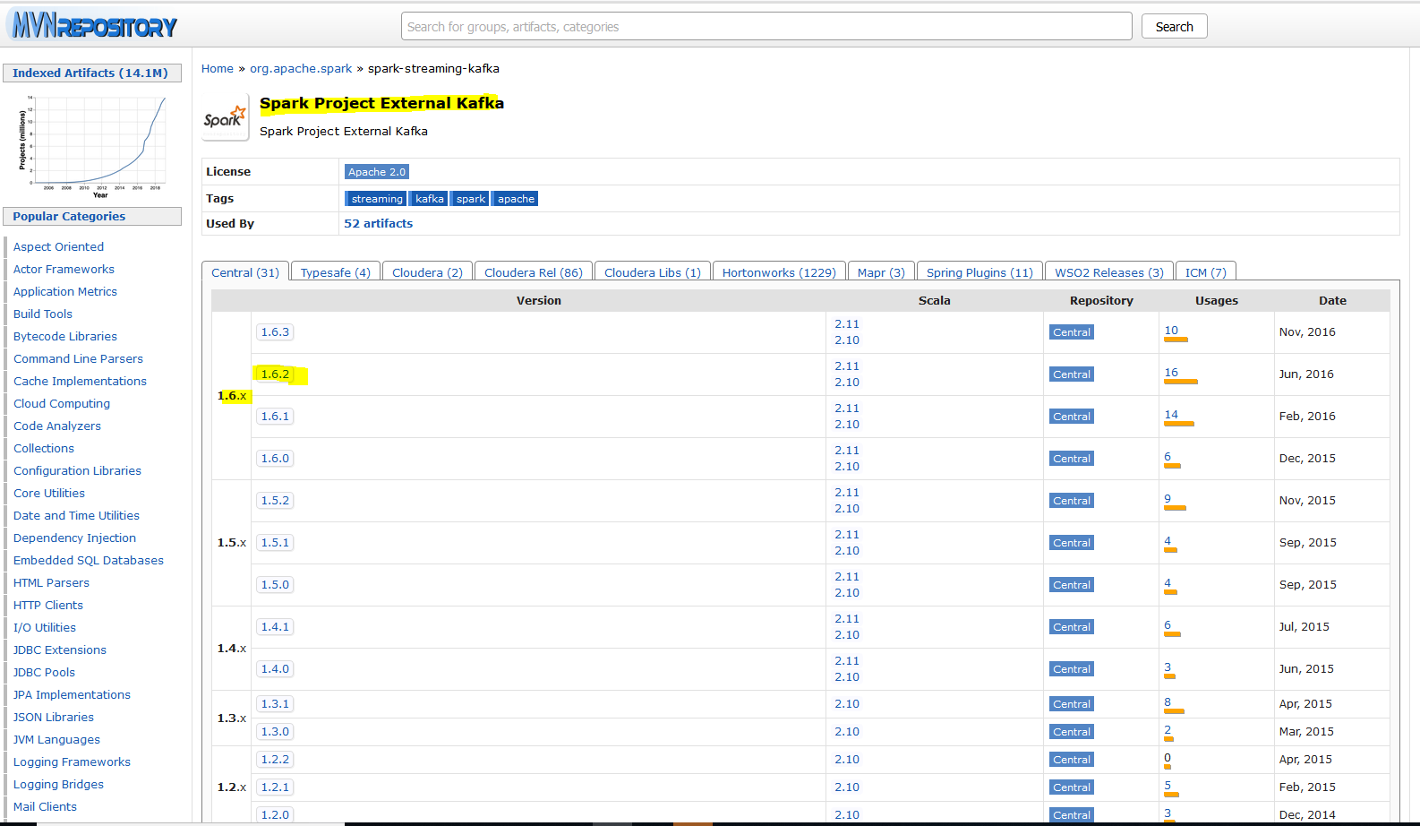

Slide 36
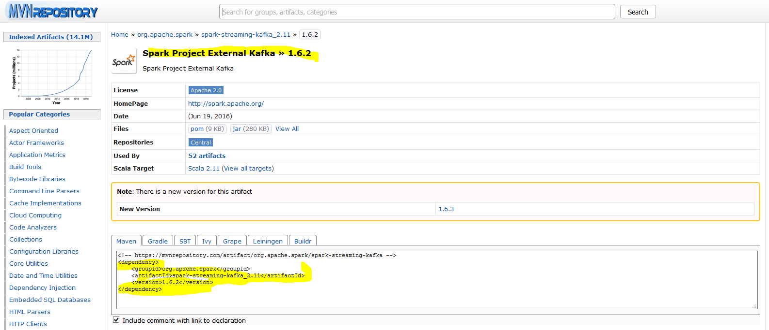

Slide 37
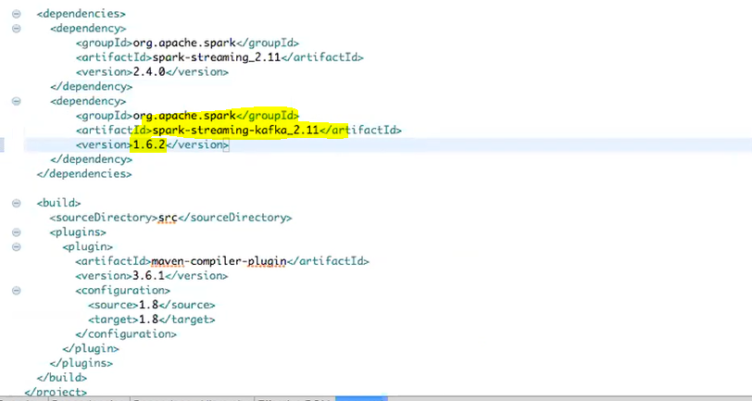
Notes:
To integerate it with Kafka we have to do it.

Slide 38
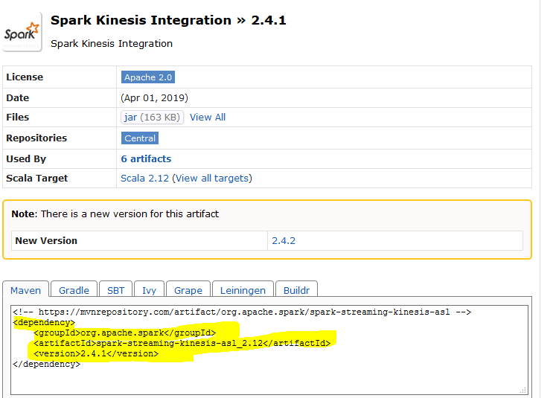
Notes:
To integrate it with Kinesis we have to do it.

Slide 39
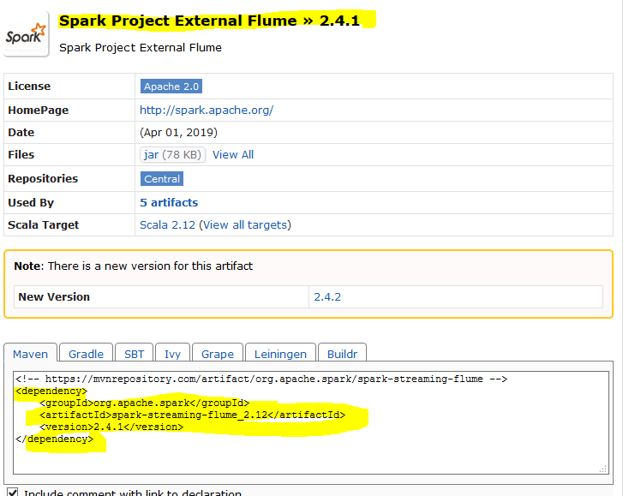
Notes:
To integrate it with flume we have to do it.

Slide 40
Custom Sources
Input DStreams can also be created out of custom data sources
Implement a user-defined receiver that can receive data from the custom sources and push it into Spark

Slide 41
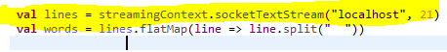
Receiver
Each streaming source is associated with a Receiver
The Receiver is that component that receives data from the source, micro-batches it & sends it across the DStream in the form of RDD’s
Each Receiver takes up 1 core (or one thread, if running locally) on the machine it is running
Consequent to the above point, each Spark Streaming application should be given sufficient number of cores (or threads) so that cores are available for the actual processing also
All DStreams except file stream uses a Receiver
Receiver
Notes:
This streamingContext is creating a receiver (socketTextStream ) to this port (21) on local host
Every source (port 21 on local host) has one receiver associated with it.
In spark program we can read from multiple sources.

Slide 42
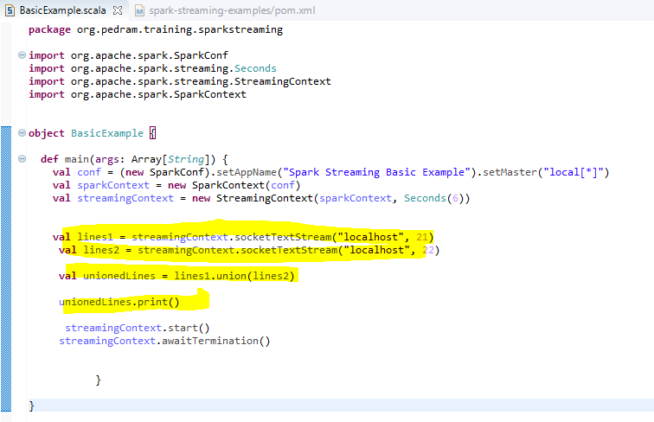
Multiple source (union and *)

Slide 43
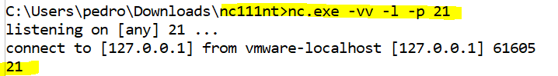
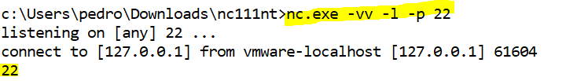
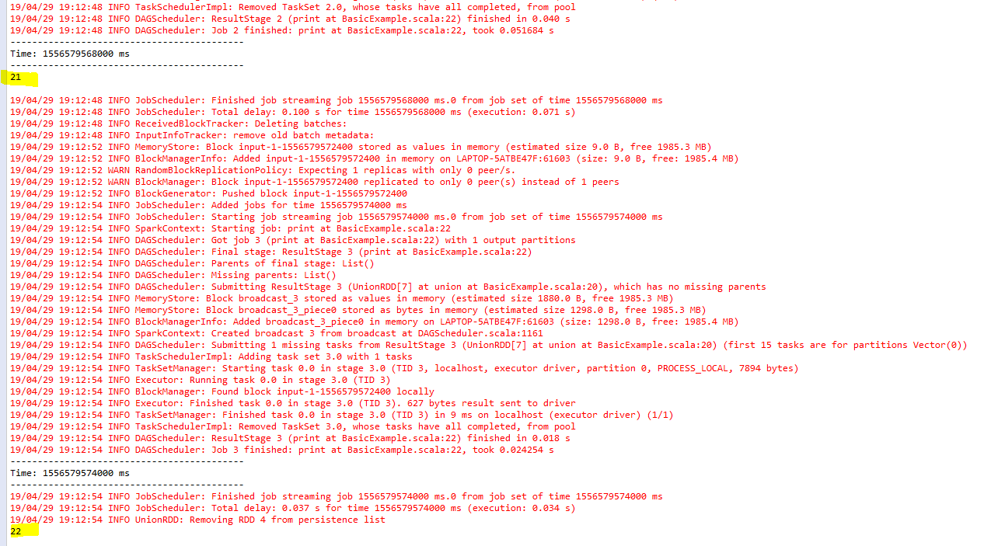
Notes:
We entered 21 in “nc port 21” within 6 second and in the 2nd 6 seconds we entered 22 in “nc port 22 “ so it union it but the first batch has only data from port 1 however the second batch has data from port 22

Slide 44
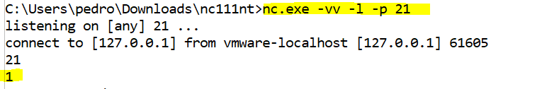
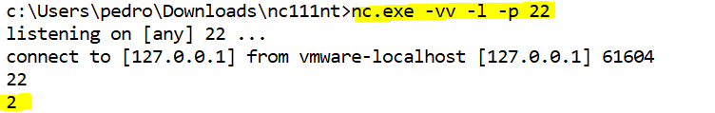
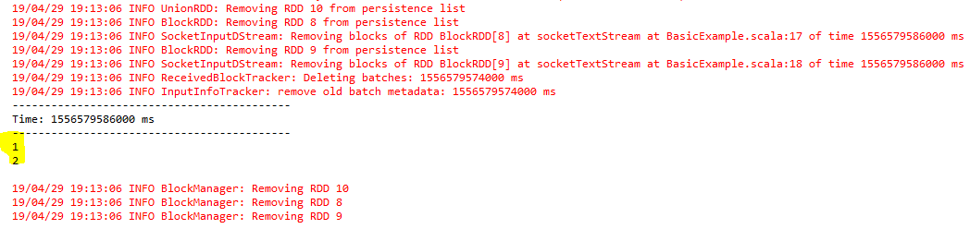
Notes:
We entered 1 in nc port 21 within 6 second and in that 6 SECOND WE ENTER 2 in nc port 22 so It will union it.

Slide 45
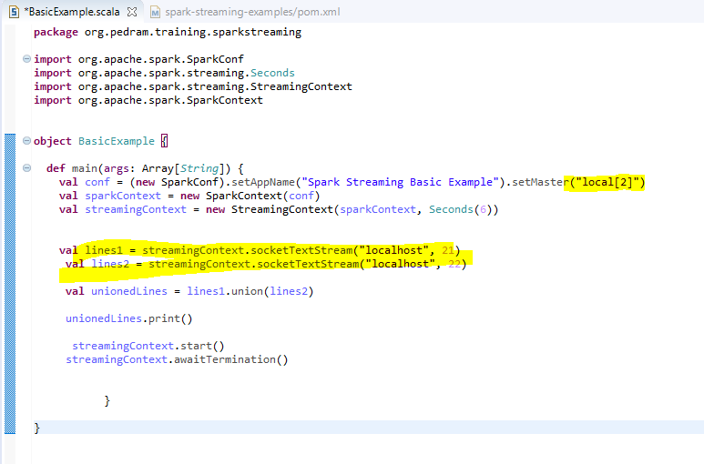
One threat per core cpu on the local machine

Slide 46
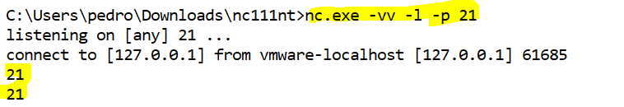
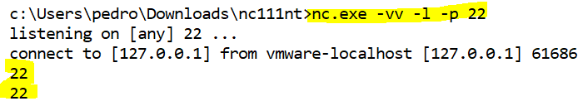
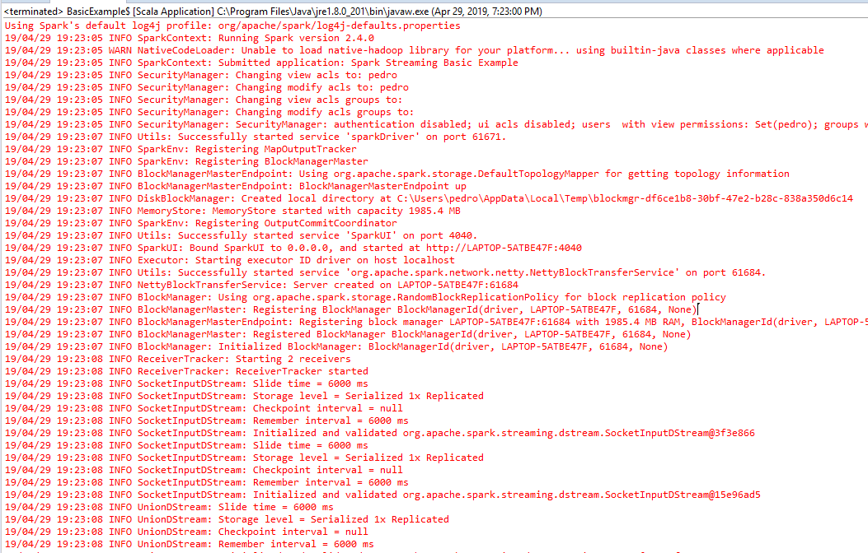
Notes:
One threat per core CPU on the local machine .You noticed that it did not print out whatever we typed in NC.
Each stream is associated with a receiver and each receiver take one core or threat .If it is locally its one threat and if it is in the cluster then one core.if this is the case who is doing the processing ? Is there any threat left ?(we assigned local[2]
Processing :
val words = lines.flatMap(line => line.split(" "))
words.print()

Slide 47
Receiver - Storage Level
Default Storage Level is Mem_Disk_Ser_2
The default storage level can be overridden while reading the stream
Notes:
Memory persist : entire things is persisted in memory
Memory_and_disk : It persists I memory if not goes to the disk
Mem_Disk_Ser_2 :The RDD which we are persisting will be persisted in memory .If can not be fitted then it will fit in disk however 2 means the partitions will be replicated in another nodes .ser for serialization
Persist and cache are same however cache is memory only .You can not specify any storage level to catch. Its always memory only.
For persist you can specify the storage level which we wish to use..

Slide 48
Receiver Reliability
Reliable Receiver: A reliable receiver correctly sends acknowledgment to a reliable source when the data has been received and stored in Spark with replication. Examples include Kafka, Flume & Kinesis Receivers.
Unreliable Receiver : An unreliable receiver does not send acknowledgment to a source. This can be used for sources that do not support acknowledgment, or even for reliable sources when one does not want or need to go into the complexity of acknowledgment.

Slide 49
DStream Transformations
map
flatMap
filter
repartition
union
count
reduce
countByValue
reduceByKey
join
cogroup
transform
updateStateByKey

Slide 50
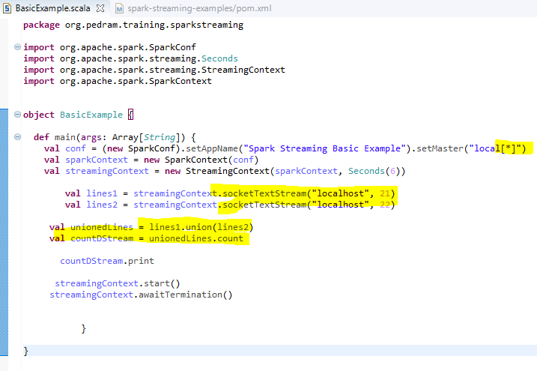

Slide 51




Slide 52

Map vs Transform
Line.transform : RDD Level
Line.flatMap : line level
Map takes the line and return a line but Transform takes an RDD and returns you a RDD
Notes:
There is a significant difference between Map and Transform
Map takes the line and return a line but Transform takes an RDD and returns you a RDD .
when you have to do some functionality on DStream which is already provided by other operations like Map use the map operation or flat Map operation or other operation
There are some custom operation that you need to do at RDD level but Dstream do not provide them. In such a case use Transform.
Line.transform : RDD Level
Line.flatMap : line level

Slide 53





Slide 54
Transform Operation
This operation is done at an RDD level
For each micro batch, which essentially is an RDD, this operation runs on the whole RDD unlike the other transformations that run on each record in the RDD
It receives an RDD & returns a transformed RDD

Slide 55

Window Operations
Applied to a group of RDD’s within a DStream
Relies on 2 parameters to function
window length - the length/duration of the window
sliding interval – the interval (in RDD) at which the window function needs to be performed
Note: These two parameters must be multiples of the batch interval of the source DStream
Slide duration is two means : every two RDD it will apply
Notes:
Window operations is not only specified to spark operation .Its specific to generic spark data set or spark RDD as well.
Window operation :The operation that you have to carry out not only in the current record that you are processing across certain records in the past.
If I apply function without windowing it will apply in the current record but what about if I want to do stateful operation or kind of history operation . Not only
I am doing operation in the current RDD (time 3) but I have history of RDD
Slide duration is two means : every two RDD it will apply .The first function will apply here (time 1) the second function will apply on time 2.
window length is 3 and sliding interval is 2.

Slide 56
Window Transformations
window(windowLength, slideInterval)
countByWindow(windowLength, slideInterval)
reduceByWindow(func, windowLength, slideInterval)
reduceByKeyAndWindow(func, windowLength, slideInterval, [numTasks])
reduceByKeyAndWindow(func, invFunc, windowLength, slideInterval, [numTasks])
countByValueAndWindow(windowLength,slideInterval, [numTasks])
Count acts on current RDD however countByWindow acts on current RDD and window Length (current RDD +2 or 3 ,…)

Slide 57


Checkpointing is failure handling mechanism
Notes:
package org.pedram.training.sparkstreaming
import org.apache.spark.SparkConf
import org.apache.spark.streaming.StreamingContext
import org.apache.spark.streaming.Seconds
object CountByWindowExample {
def main(args: Array[String]) {
val conf = (new SparkConf).setAppName("CountByWindowExample").setMaster("local[*]")
val streamingContext = new StreamingContext(conf, Seconds(1))
streamingContext.checkpoint("C:/Users/pedro/Documents/test_data/check_point")
val dStream = streamingContext.socketTextStream("localhost", 21)
val windowedCountDStream = dStream.countByWindow(Seconds(3), Seconds(2))
windowedCountDStream.print()
streamingContext.start()
streamingContext.awaitTermination()
}
}

Slide 58



Every 2 second
Notes:
Every 2 second

Slide 59







Slide 60


Slide 61


Slide 62
DStream Actions
print()
saveAsTextFiles(prefix, [suffix])
saveAsObjectFiles(prefix, [suffix])
saveAsHadoopFiles(prefix, [suffix])
foreachRDD(func)
* [func runs on the driver. However, the actual operations on the RDD’s execute on the executor nodes on which the RDD partitions reside.]

Slide 63

Every batch it creates it save it as text file at this location. This is not different from what we saw for RDD
Notes:
.

Slide 64




Slide 65


Slide 66



Slide 67



Slide 68




Slide 69


ForeachRDD(func)
4*2
Every 4th batch (8s) it will
write the data (4RDD)
Every 10 second the file will be replaced
Notes:
foreachRDD(func) :It will take an action for the current RDD 4*2
foreachRDD(func)
* [func runs on the driver. However, the actual operations on the RDD’s execute on the executor nodes on which the RDD partitions reside.]
Seconds(10), Seconds(8) : Every 10 second the file will be replaced. The window interval is 10 seconds.(the batch duration is 2 s) but I took window as 10 seconds basically I am taking 5 windows.and after every 4th windows I am writing the data
Every 2 seconds there will be one RDD .Every 10 seconds I have 5 RDD and my slides interval is 8 seconds .Every 4th batch it will write the data Seconds(8)
=========================================================================================================================
Every 8 second this count operation (“windowedCountDStream”) will be executed then I am doing foreachRDD operation that means once the count operation (“windowedCountDStream”) is executed it basically contains a single RDD containing the count of all the RDD across the window (Seconds(10), Seconds(8))
val windowedCountDStream = dStream.countByWindow(Seconds(10), Seconds(8))
Next I will do the foreachRDD that means the countrdd which contains the RDD with the count for all the five windows means current RDD + 4 previous RDD (that is my current RDD)
I am just saving as text file
windowedCountDStream.foreachRDD(rdd => {
rdd.saveAsTextFile("C:/Users/pedro/Documents/test_data/output")

Slide 70


Notes:
Seconds(10), Seconds(8) : Every 10 second the file will be replaced

Slide 71

foreachRDD(func)
Next Example
Notes:
foreachRDD(func)
* [func runs on the driver. However, the actual operations on the RDD’s execute on the executor nodes on which the RDD partitions reside.]

Slide 72


Notes:
Every 4 seconds there is a file written

Slide 73



Notes:
This “dStream” contains the records for 2 seconds Seconds(2))
val dStream = streamingContext.socketTextStream("localhost", 21)
Next I created window dstream “windowedCountDStream” that means I am not taking my current RDD (Seconds(10) I am going back 10 seconds that means if 2 seconds is my current RDD then the 10 seconds will give me 4 more previous RDD
val windowedCountDStream = dStream.window(Seconds(10), Seconds(8))
Then I am saying my slide interval is 8 seconds Seconds(8)) means every 4 RDD or every 8 seconds slide the window

Slide 74
We are not applying any function here (previously we applied the count function)
Original DStream
Previously
Notes:
Previously

Slide 75

foreachRDD(func)
* [func runs on the driver. However, the actual operations on the RDD’s execute on the executor nodes on which the RDD partitions reside.]

Slide 76


Slide 77
Convert Streaming Data to Dataframes
val dStream = …
dStream.foreachRDD(rdd => {
// Get the singleton instance of SparkSession
val spark = SparkSession.builder.config(rdd.sparkContext.getConf).getOrCreate()
import spark.implicits._
// Convert RDD[String] to DataFrame
val df = rdd.toDF()
// Create a temporary view or run sql on the df
df.createOrReplaceTempView("words")
df.show()
}

Slide 78

1st batch
2nd batch
3rd batch

Slide 79

Notes:
We make sure we import the right dependency .As we are going to do some sql so we need to install the sql dependency.

Slide 80

Notes:
We assume that we receive the salesjan2009 as streaming data
There are many situation in which we convert our data to data frame and do sql operation on it.
For example salesjan2009 comes as streaming data .the first 10 row as first batch ,the second 10 row as the second batch,…(this is structured data)
Once we have our structure data coming as part of streaming data and we split our batches to 5 seconds and each 5 seconds we are receiving 10 rows.what will happen?
Each batch contains x numbers of records. this is essentially is streaming data
Can we run sql operation in RDD or any structured operation in RDD? no we have to convert it to data frame
==============================================================
package org.pedram.training.sparkstreaming
import org.apache.spark.SparkConf
import org.apache.spark.streaming.StreamingContext
import org.apache.spark.streaming.Seconds
import org.apache.spark.streaming.dstream.DStream.toPairDStreamFunctions
import java.time.Instant
import org.apache.spark.sql.SparkSession
object ReduceByKeyAndWindowExample {
def main(args: Array[String]) {
val conf = (new SparkConf).setAppName("ReduceByKeyAndWindowExample").setMaster("local[*]")
val streamingContext = new StreamingContext(conf, Seconds(2))
streamingContext.checkpoint("C:/Users/pedro/Documents/test_data/check_point")
val sparkSession = SparkSession.builder().appName("CountByWindowExample").master("local[*]").getOrCreate()
import sparkSession.implicits._
val dStream = streamingContext.socketTextStream("localhost", 21)
val windowedCountDStream = dStream.window(Seconds(10), Seconds(8))
windowedCountDStream.foreachRDD(rdd => {
println("Hello")
val df = rdd.toDF()
val largeSalesDF = df.select($"salesAmt" > 1000)
df.write.format("csv").partitionBy("country").save("path ")
})
streamingContext.start()
streamingContext.awaitTermination()

Slide 81
Remember Previous RDD’s
StreamingContext.remember(duration: Duration)
The DStream usually forgets an RDD once it has been processed
In such a case, the DStream moves on to the next RDD
There may be situations where a certain previous RDD needs to be remembered
In such a case, use this method. It will remember all previous RDD’s upto the mentioned duration.

Slide 82

You do not have to do this example .This is to show you what we can do with our data stream
Notes:
If we do not use “streamingContext.remember(Seconds(8))” then dStream.map(line => line) apply for current rdd.
By using “streamingContext.remember(Seconds(8))” the “ dStream.map(line => line) “ will apply to the current rdd and the previous 4 rdd (2*4)

Slide 83
Persist Operations
Like RDD’s, DStreams can also be persisted using the persist() method
DStreams resulting from window operations are automatically persisted without the user calling persist() explicitly on it
For input streams that receive data over the network (such as, Kafka, Flume, sockets, etc.), the default persistence level is set to replicate the data to two nodes for fault-tolerance
Note that, unlike RDDs, the default persistence level of DStreams keeps the data serialized in memory

Slide 84
Persist RDD’s
MEMORY_ONLY (the entire data has persisted to memory)
MEMORY_AND_DISK (The entire data has persisted to memory .If it can not fit then it goes to the disk)
MEMORY_ONLY_SER (in serialized format)
MEMORY_AND_DISK_SER
DISK_ONLY
MEMORY_ONLY_2 (2 :replicate on two nodes(fault tolerance)
MEMORY_AND_DISK_2
Serialized take less space however every time you need to de serialized it .and there is a consequences like CPU overhead

Slide 85
Lazy Evaluation
Load -> Transformation 1 [-> Transformation 2 -> Transformation 3 -> Transformation 4 -> Transformation 5] -> Action
Example:
Load -> map -> filter -> count
Load -> Transformation 1 -> Transformation 2 -> Action
Load -> Transformation 1 -> Transformation 3 -> Action
----------------------------------------------------------------------------------------------
So two Dages will be created .Spark will execute the first one the second line. The problem is “Load -> Transformation 1 “ will be executed twice which is wastage.
Load -> Transformation 1 ->Persist
-> Transformation 2 -> Action
-> Transformation 3 -> Action
So with persist we can save “Load -> Transformation 1 “ we can use previous slide
We can tell spark how to save it .That's storage level

Slide 86
Checkpointing
Why use checkpointing?
Driver node failure: This causes some data that is received but not yet processed to be lost
Data loss during window operations: Since these rely on a series of previous batches (RDD’s), any failure during the current batch processing will lose the data from the previous batches. Spark is capable of recovering the current batch, by default. But, since these operations rely on the previous batches also, that data cannot be recovered.
Checkpointing is failure handling mechanism. spark is resilience (Rdd can be re constructed)
Notes:
Driver coordinates the executers and transfer the job but if driver itself is lost then the entire job is lost so data might be in corrupted format.
In data lost when we are doing data operation or “remember operation” the spark streaming needs to remember the previous rdd .Thats the only way it can achieve windowing
Assume one of the window fails so what will happen is the data is lost so it can not recover the previous windows
Lets assume the window has 5 rdd ,out of 5 rdd one of the window fails so the current Rdd will reconstructed that’s why spark is resilience (Rdd can be re constructed)
What about the previous RDD? They have to be saved so that’s why spark gives us failure handling mechanism
Checkpointing is failure handling mechanism that we can say we want to check point the data .it means we want to save the data (either the data or meta data) associated with current job
From time to time

Slide 87

Notes:
package org.pedram.training.sparkstreaming
import org.apache.spark.SparkConf
import org.apache.spark.streaming.StreamingContext
import org.apache.spark.streaming.Seconds
import org.apache.spark.streaming.dstream.DStream.toPairDStreamFunctions
import java.time.Instant
import org.apache.spark.sql.SparkSession
object CountByWindowExample {
def main(args: Array[String]) {
val conf = (new SparkConf).setAppName("CountByWindowExample").setMaster("local[*]")
val streamingContext = new StreamingContext(conf, Seconds(2))
streamingContext.checkpoint("C:/Users/pedro/Documents/test_data/check_point")
val dStream = streamingContext.socketTextStream("localhost", 21)
val mappedDStream = dStream.map(line => (line, 1))
val checkpointedDStream = mappedDStream.checkpoint(Seconds(1)) //check point the actual data
mappedDStream.print()
streamingContext.start()
streamingContext.awaitTermination()

Slide 88






Driver node failure
Data
Meta Data
Meta Data for actual data
Notes:
If there is a driver node failure what essentially will happen is spark will go to the check point directory and pick up the check point and it will be able to run the job
From where the job essentially failed.
Check pointing retains only the latest one
We also check pointed the data
val checkpointedDStream = mappedDStream.checkpoint(Seconds(1)) //check point the actual data

Slide 89
Checkpointing
Which data needs to be checkpointed?
Metadata
Configuration - The configuration that was used to create the streaming application
DStream operations - The set of DStream operations that define the streaming application
Incomplete batches - Batches whose jobs are queued but have not completed yet
Data: Saving of the generated RDDs to reliable storage. This is necessary in some stateful transformations that combine data across multiple batches.

Slide 90

Persist vs. Checkpoint
Notes:
There is significant difference between persist and checkpoint:
==========================================
1.Check point stores the data and then when the job is reexecuted the current rdd will read from check point “val checkpointedDStream = mappedDStream.checkpoint(Seconds(1))”
Without constructing the entire lineage spark dag .Every spark program has a dag associated with it.for check pointing the dag is calculated from where the check point is stored
But if you do persist your dag will be calculated right from the beginning. In persist the entire dag will be created however in check point the dag starts from check point directory
2.Check point will retain the data for ever .Persist remove the data when the job is finished .
3.Check pointing will take care of driver failure that means it can restart the job from where the driver failed whereas persist you can not restart the job.you have to restart the job from the beginning. Because in persist your dag is calculated from the beginning.
Persist will be saved in the spark warehouse directory.

